Slide 1


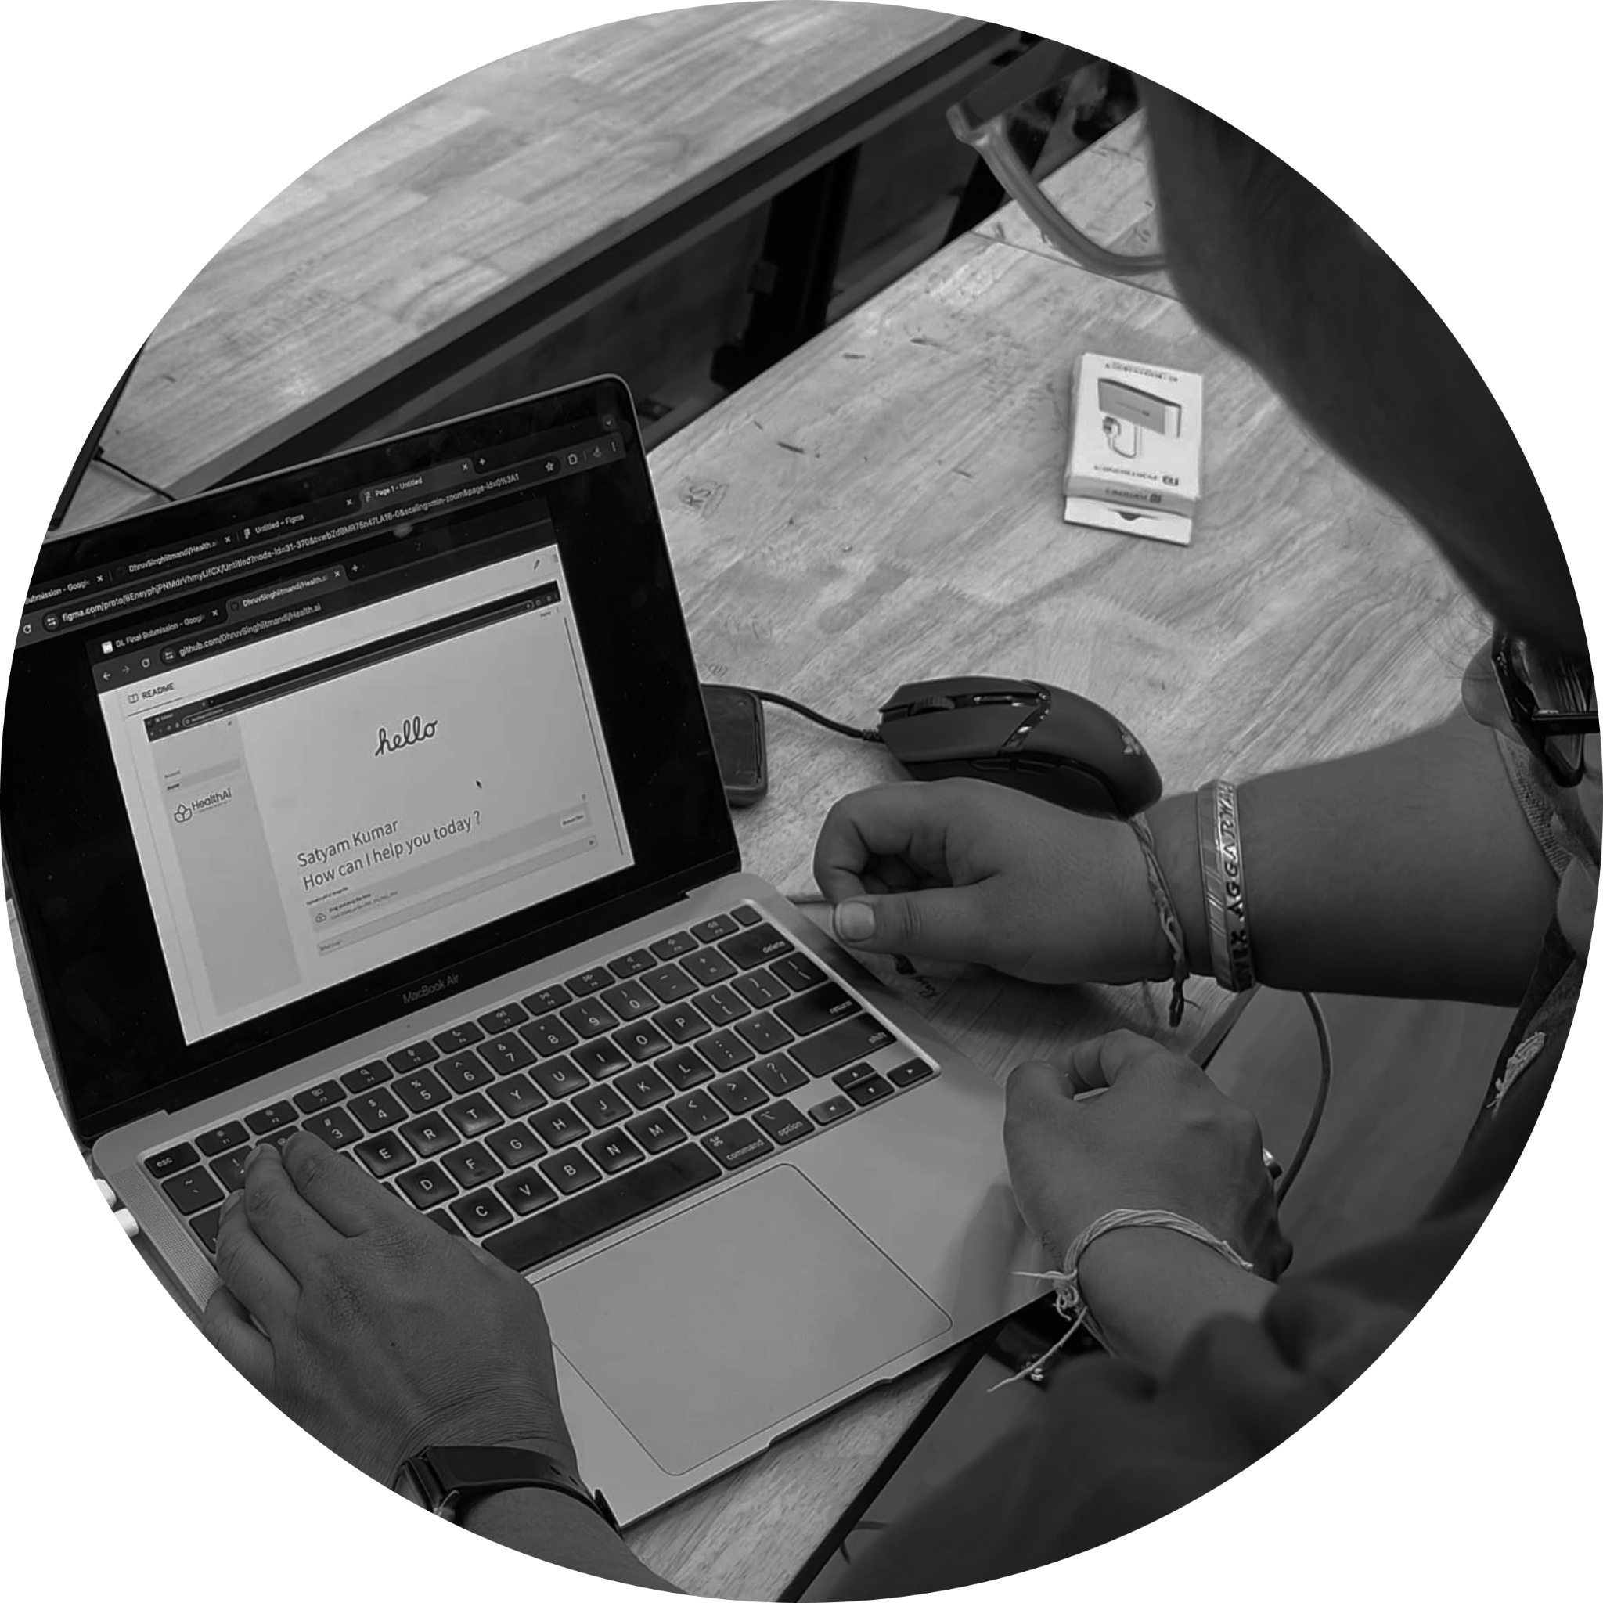


YOUR LOGO ABOUT PROJECT PRICE TEAM
OPDx
PATIENT MEDICAL HISTORY AWARE HEALTH ASSISTANT
GROUP P12-A
Mentor: Anoushkrit Goel

Slide 2






PROJECT TEAM
YOUR LOGO ABOUT PROJECT PRICE TEAM
Aryan Singh
B22260, EP
Anoushkrit Goel
S22042, Mentor
Luv Sharma
B22115, CSE
Satyam Kumar
B22236, CSE
Dhruv Singh
B22101, CSE
Vivek Aggarwal
B22145, CSE

Slide 3
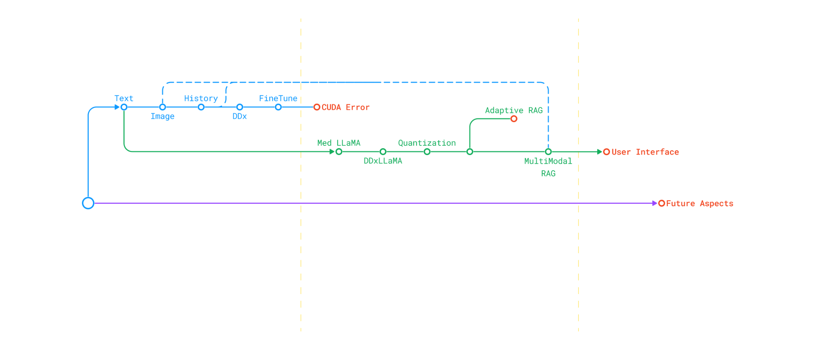
Workflow Timeline

Slide 4
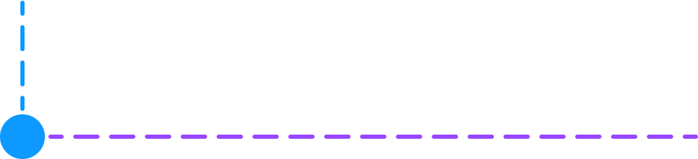
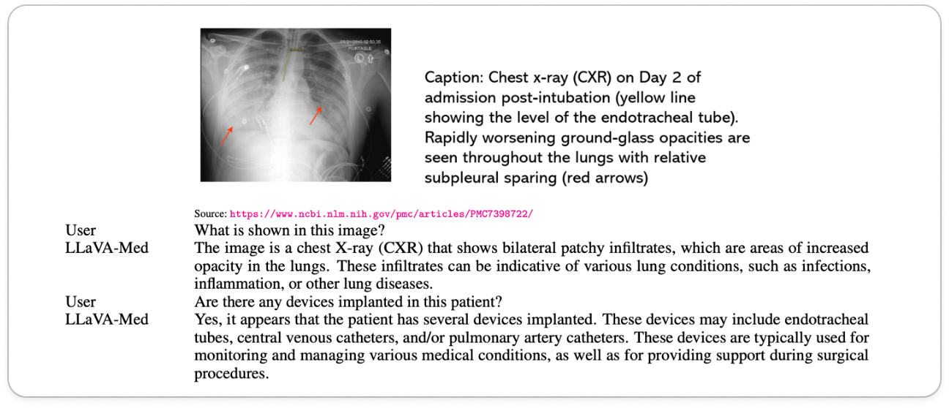
YOUR LOGO ABOUT PROJECT PRICE TEAM
LLaVA Med
NeurIPS(2023)
Large Language & Vision Assistant for BioMedicine by Microsoft Researchers
[PMC-15M, Self-generated Instruction-Following Data]
Why choose LLaVA Med?
01
OpenSource
02
MultiModal
Notes:
difference between gpt and this , chest X ray image

Slide 5
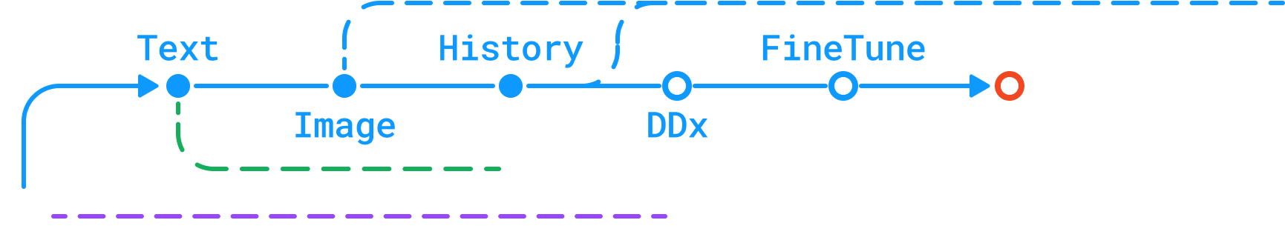



YOUR LOGO ABOUT PROJECT PRICE TEAM
LLaVA-Med: Accessibility Solutions
Problems
Solutions
Local Compute Limitations
Transition To Param
Insufficient computational resources locally necessitated seeking alternative solutions.
Utilizing supercomputer PARAM (IIT Mandi supercomputing facility) could overcome the local compute limitations.
Inability To Generate Inference
Modifications To Llava-Med Codebase
No proper documentation support from LLaVA-Med and incompatibility with the Gradio chatbot component.
Altered files test_message.py & model_worker.py to enable image and text inference along with history of conversation.
Notes:
camel case

Slide 6

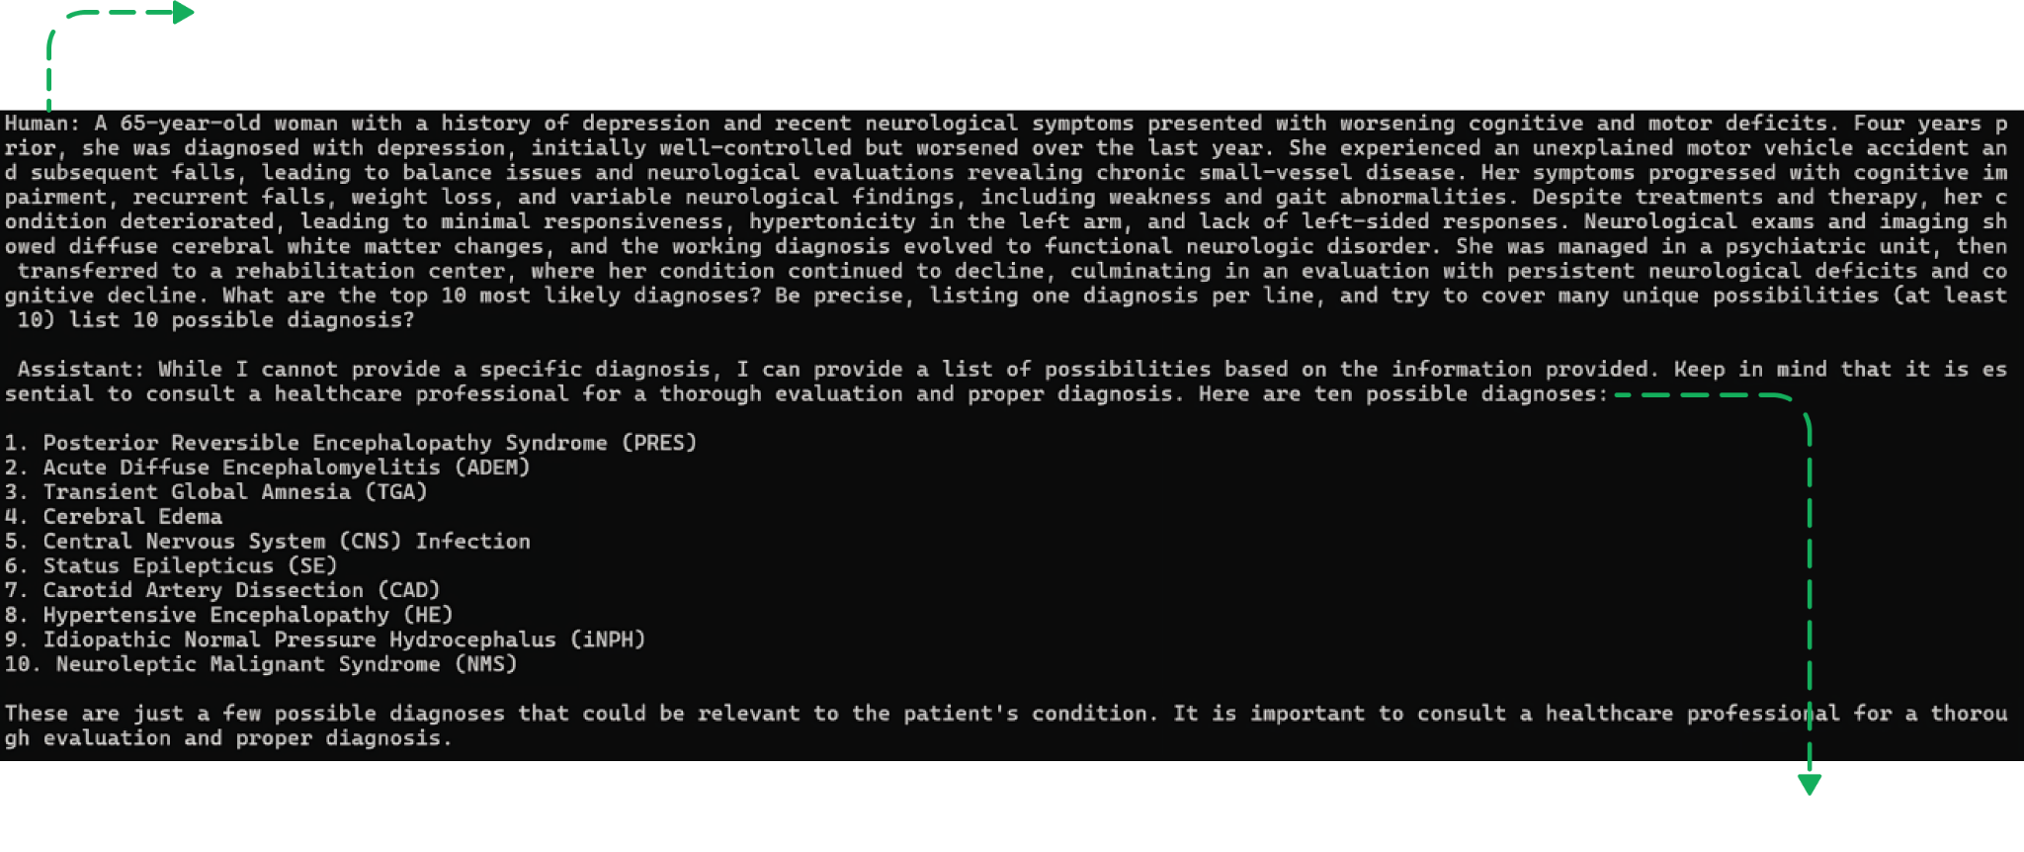
YOUR LOGO ABOUT PROJECT PRICE TEAM

Slide 7
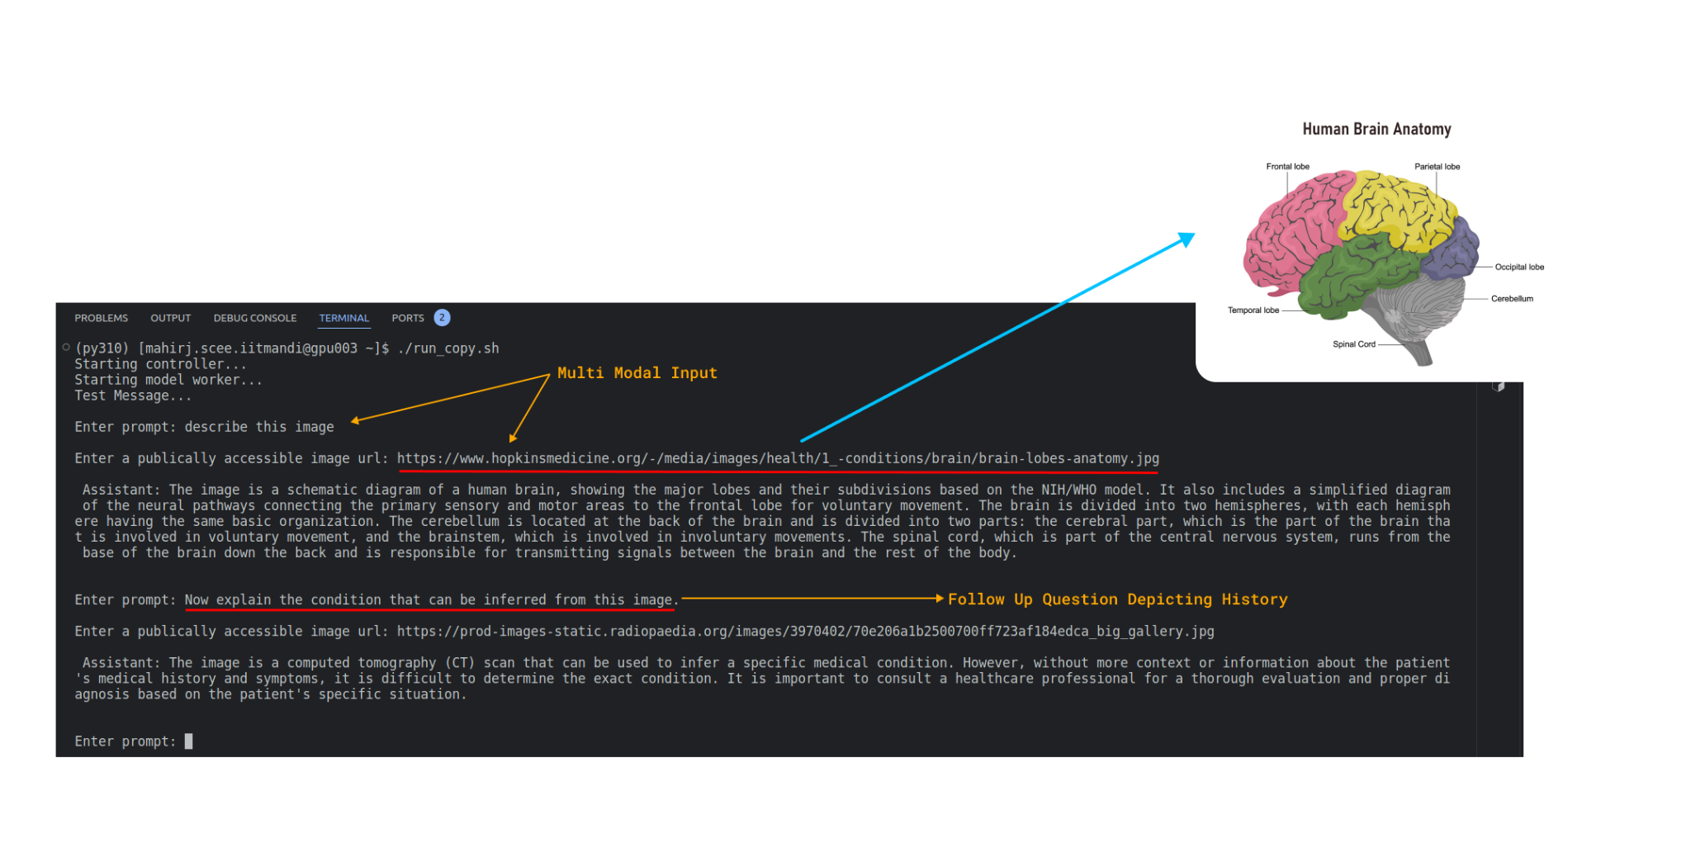

YOUR LOGO ABOUT PROJECT PRICE TEAM
Multi Modality

Slide 8


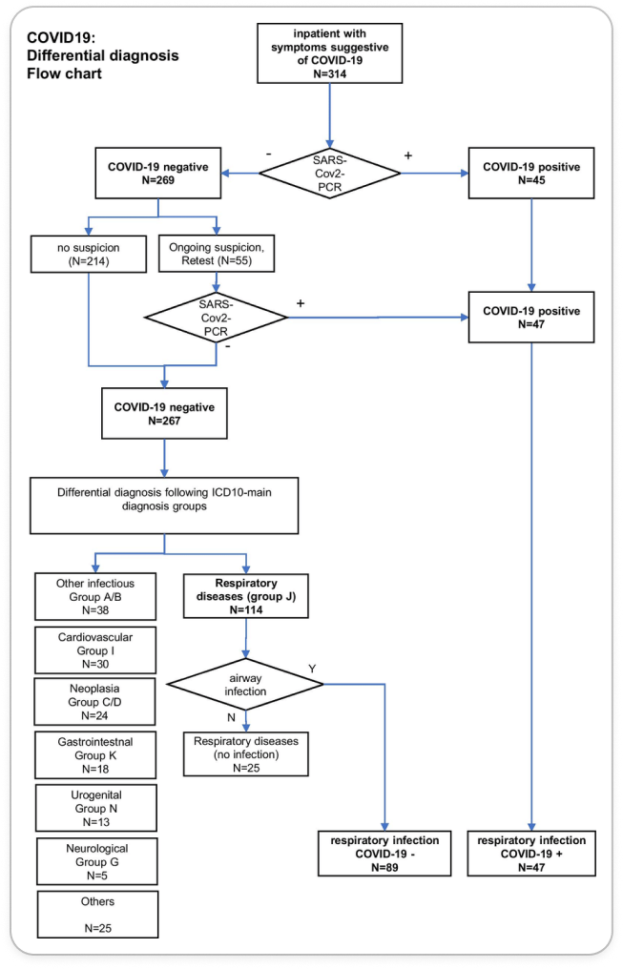

Introduction To DDx
DIFFERENTIAL DIAGNOSIS (DDx) is the medical detective work of considering all possible diagnoses for a patient's symptoms. By creating and refining a list based on factors like symptoms , antecedents and tests, helping doctors to reach the most accurate diagnosis, ultimately leading to better patient care.
Importance and Relevance of DDx
It is the cornerstone of accurate medical care. It ensures a doctor considers all possibilities, preventing them from missing a serious condition with similar symptoms. This not only reduces misdiagnosis but also guides targeted treatment plans and fosters informed communication with patients, leading to the best possible healthcare outcomes.
An example flowchart of DDx

Slide 9
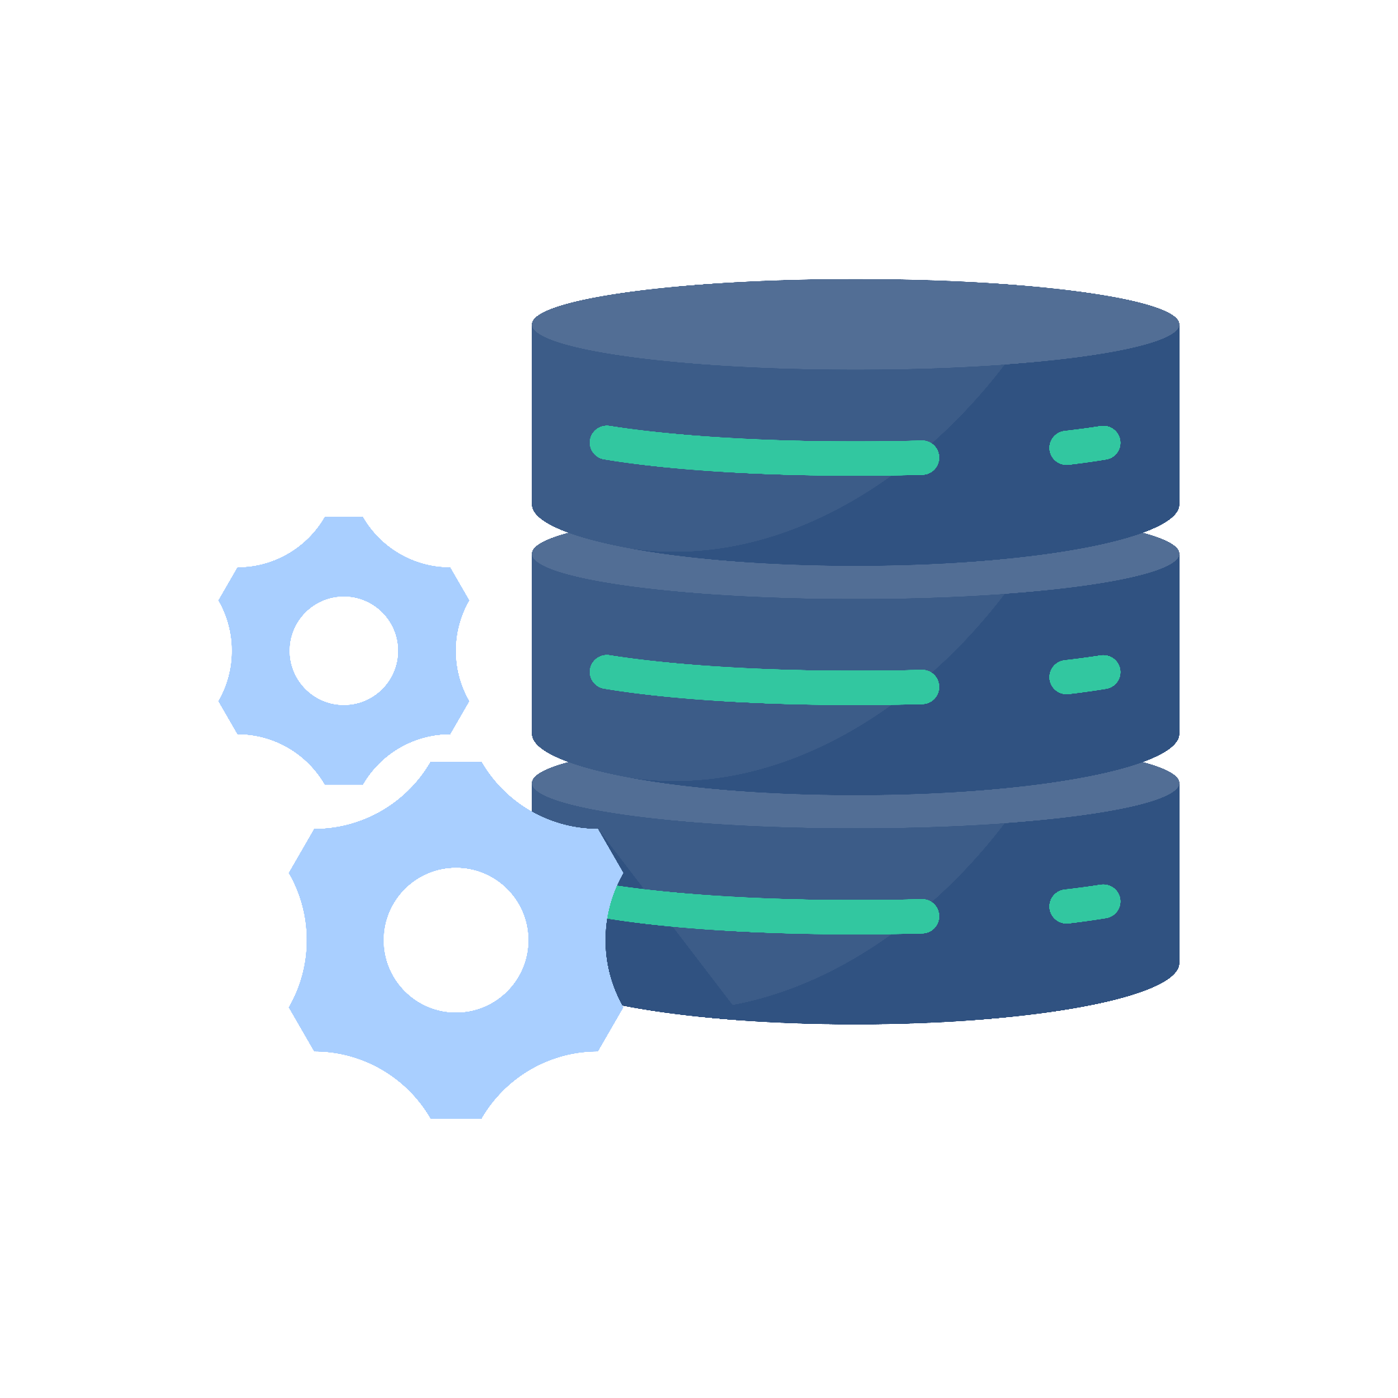
DDxPlus Dataset
[Mila Quebec]
Hierarchical DDx
Scale And Variety
Unlike existing datasets that only consider symptoms, DDxPlus distinguishes between symptoms and antecedents organized hierarchically.
Boasts a larger scale, encompassing more patients, pathologies, symptoms, and antecedents compared to previous datasets.
Richer Data
The Power Of DDx
large-scale synthetic benchmark dataset of roughly 1.3 million patients covering 49 pathologies, 110 symptoms and 113 antecedents.
Includes a differential diagnosis for each patient, alongside the confirmed pathology and inclusion with non-binary symptoms and antecedents.

Slide 10
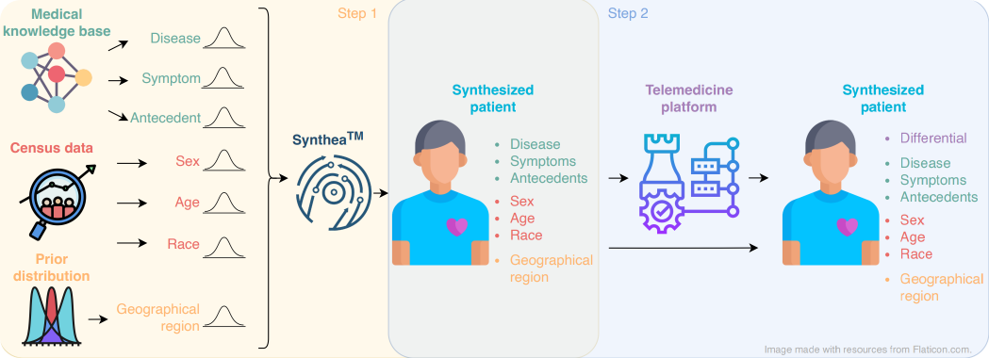
Overview Of The Data Generation Process Of DDxPlus

Slide 11
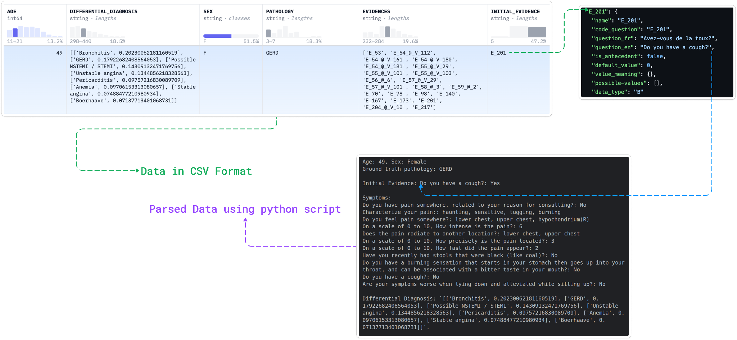
Using Parser

Slide 12
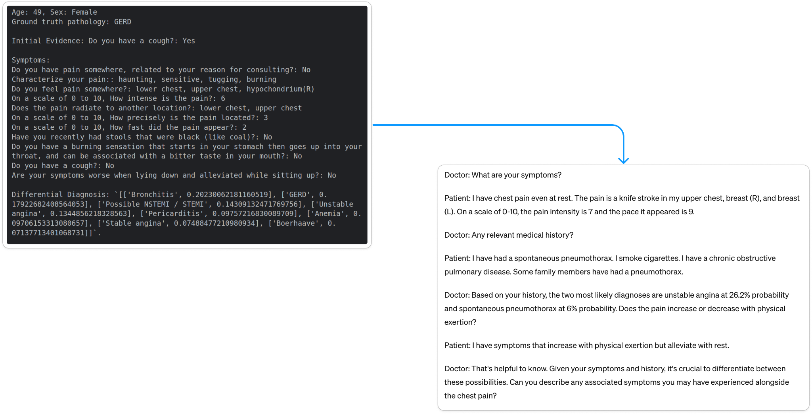
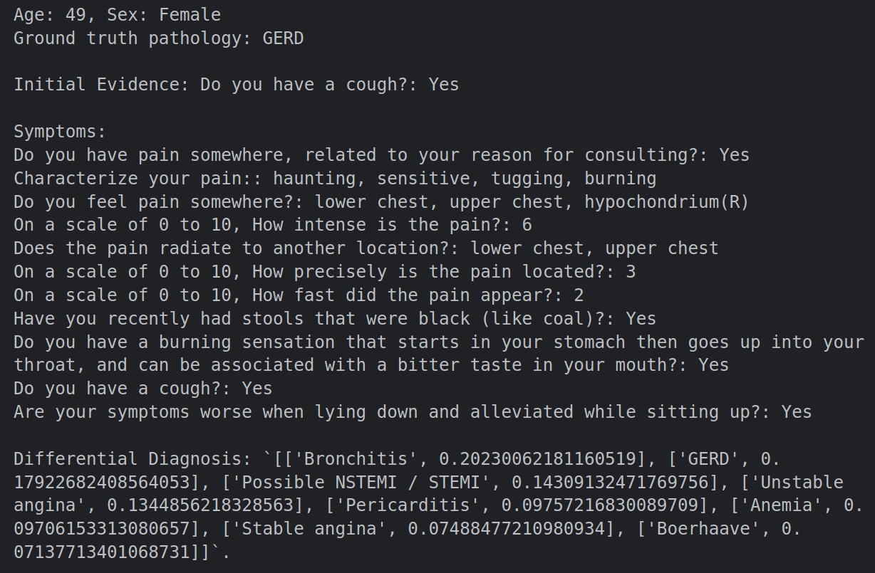
From LLaVA med we got to know that it was hierarchical data

Slide 13

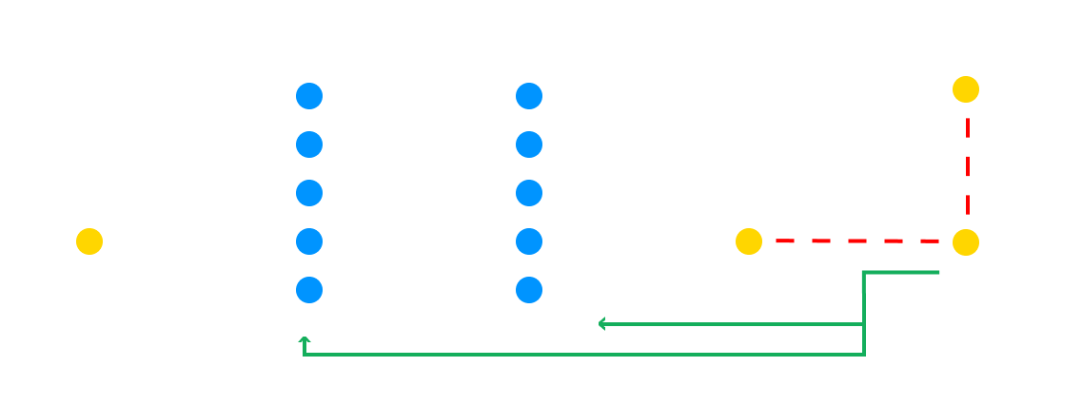
t
Fine-Tuning
Training A Pre-Trained Network On New Data To Improve Its Performance On A Specific Task.

Slide 14

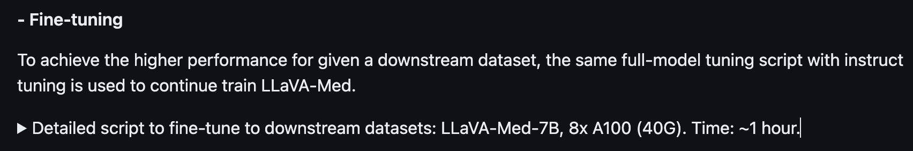
GPU Requirements
Tried Fine-Tuning LLaVA Med on PARAM

Slide 15
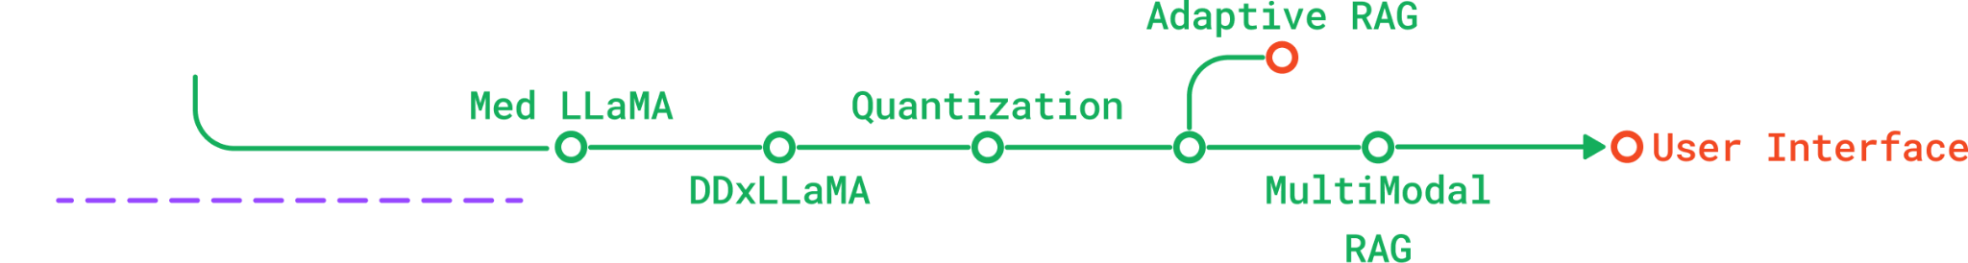
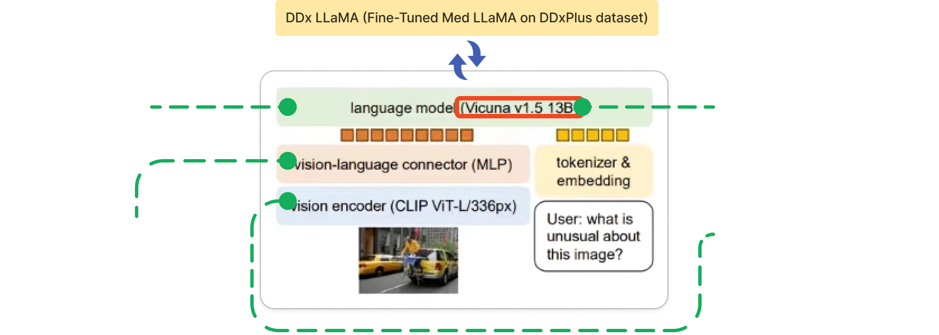
LLaVA Med’s Architecture

Slide 16
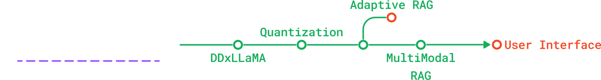
Med LLaMA 2
[LLaMA 2,MedQA]
Med Llama 2 is a Llama 2-based model trained with MedQA dataset to be able to provide medical answers to questions.
Why?
LLaMA Variant
Limitations Of DDx Dataset
To avoid compatibility issues, we switched to Med-Llama, which also uses the llama architecture, ensuring a smooth integration.
DDx dataset wasn't comprehensive enough for medical needs. So, we chose Med-Llama, a model trained on medical questions and answers (MedQA).
Notes:
kispe trained h - DATASET NAMES

Slide 17
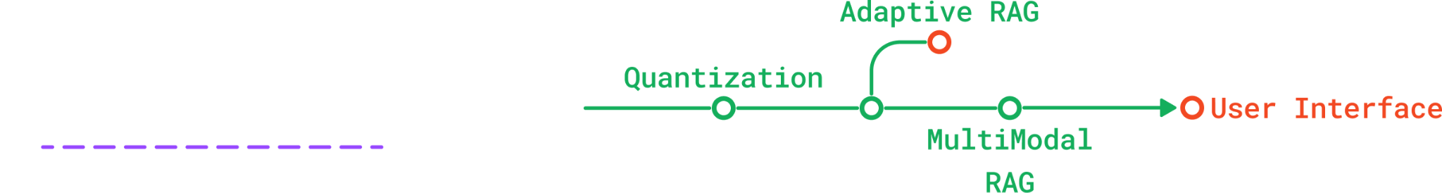
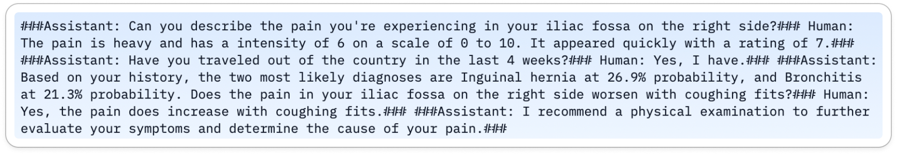
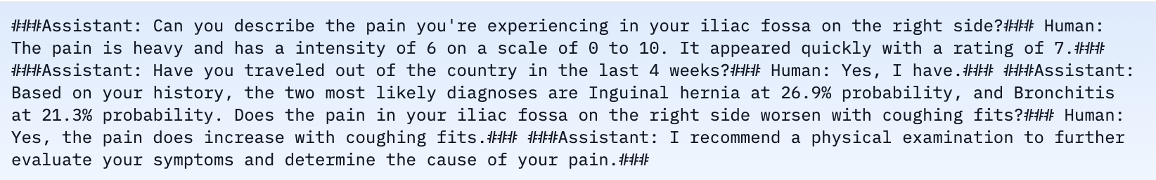
PEFT Med LLaMA Using QLoRA
MedLlama2 is a Llama 2-based model trained with MedQA dataset to be able to provide medical answers to questions.
DDx -> Medical Conversation Format
Conversational data was modified to format that llama is compatible with for fine-tuning.

Slide 18
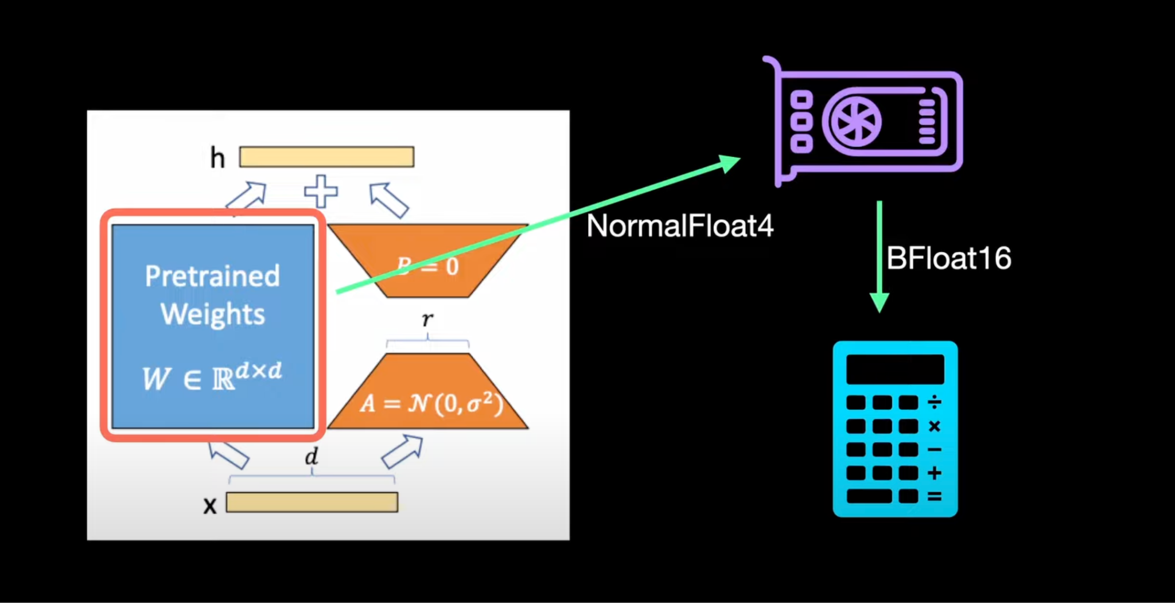
LoRA is an improved fine tuning method where instead of fine tuning all the weights that constitute the weight matrix of the pre-trained large language model, matrices that approximate this larger matrix are fine-tuned.
QLoRA builds on LoRA by incorporating quantization techniques to further reduce memory usage while maintaining, the model performance with minimal loss
LoRA
QLoRA
Notes:
Lora na lag jae

Slide 19
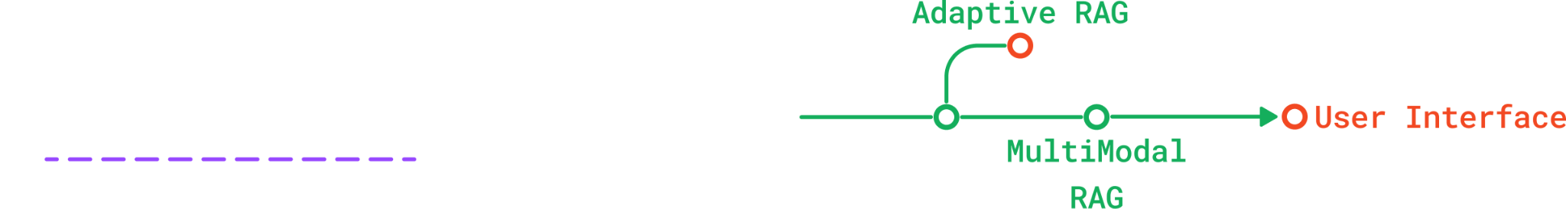
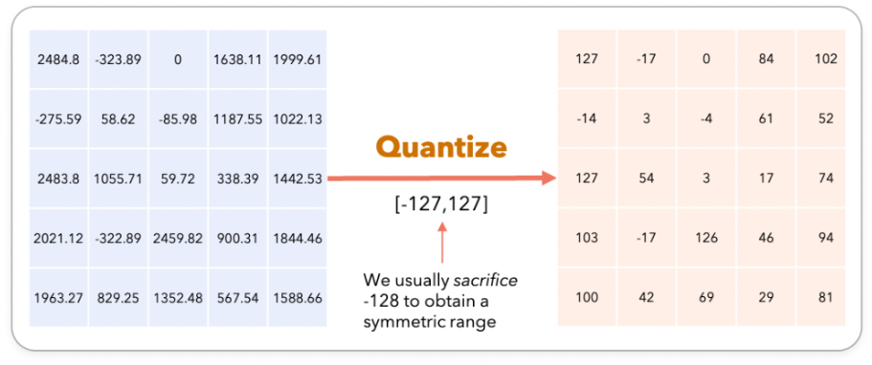
Quantization
It is a compression technique that involves mapping high precision values to a lower precision one. For an LLM, that means modifying the precision of their weights and activations making it less memory intensive.
Notes:
acchi photo

Slide 20
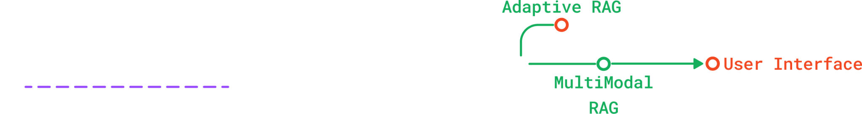
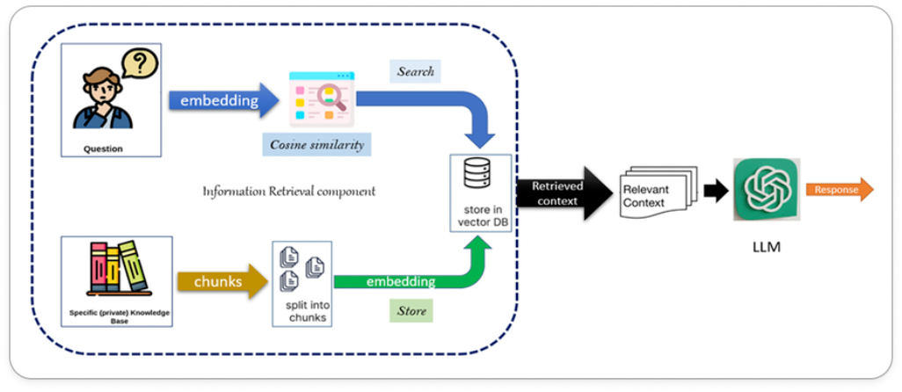
Retrieval Augmented Generation (RAG)
RAG is a technique for enhancing the accuracy and reliability of generative AI models with facts fetched from external sources.

Slide 21
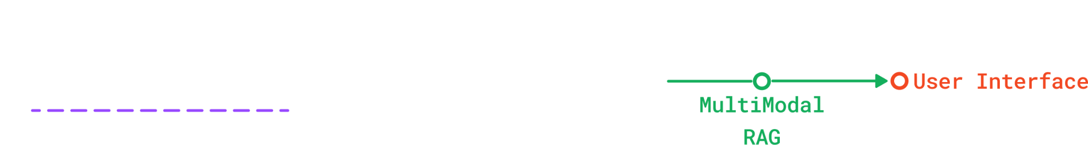
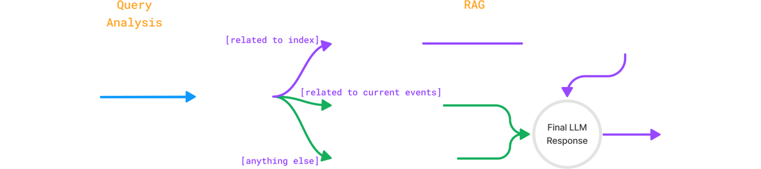
Adaptive RAG
Adaptive RAG builds on RAG by dynamically searching the web, tailoring results to the user's specific needs.
While powerful, it wasn't ideal for our medical chatbot due to the unreliability of web-based medical information.

Slide 22
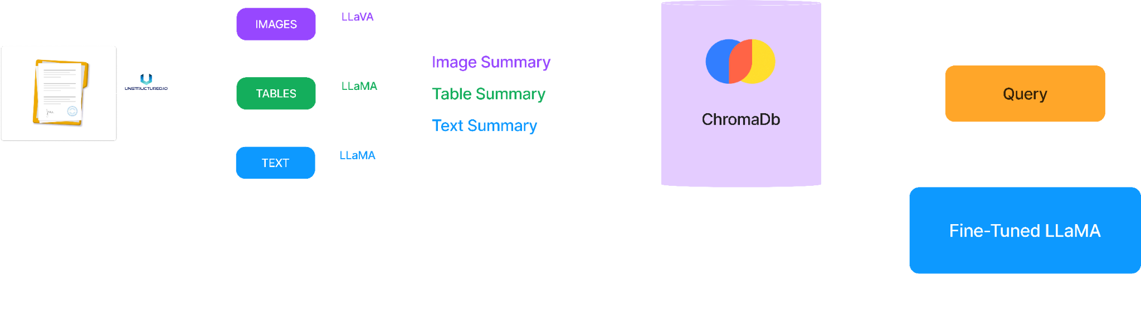
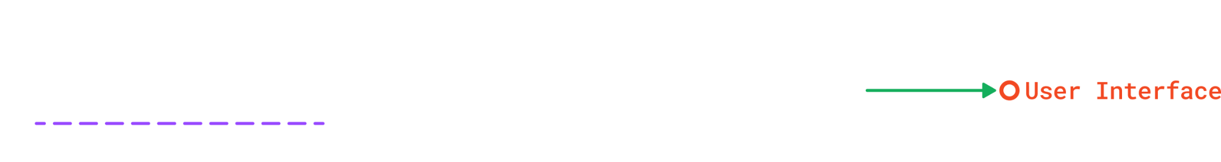
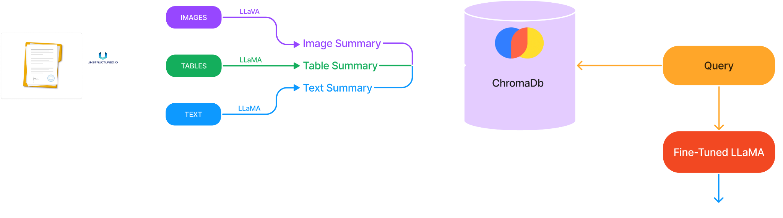
Multi-Modal RAG
Technique that expands upon RAG to encompass different data types. MM-RAG goes beyond text, allowing the LLM to consider information from images, tables, and other formats. Creating a more versatile system that can understand and respond to questions based on a wider range of data.

Slide 23
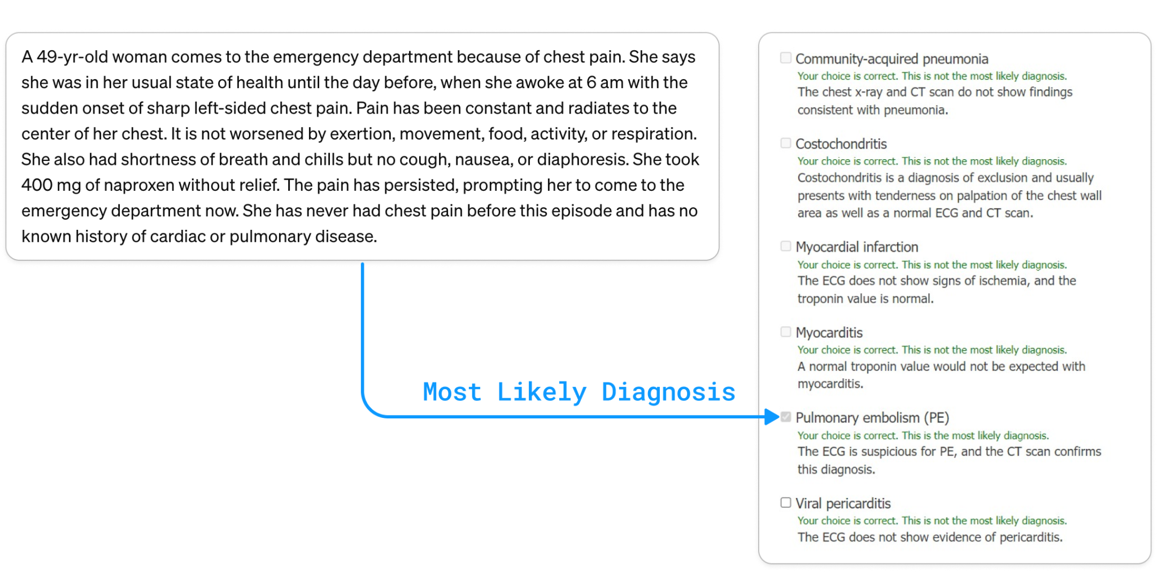
Comparison between GPT-3.5 and DDx LLaMA
Case Study From MSD

Slide 24
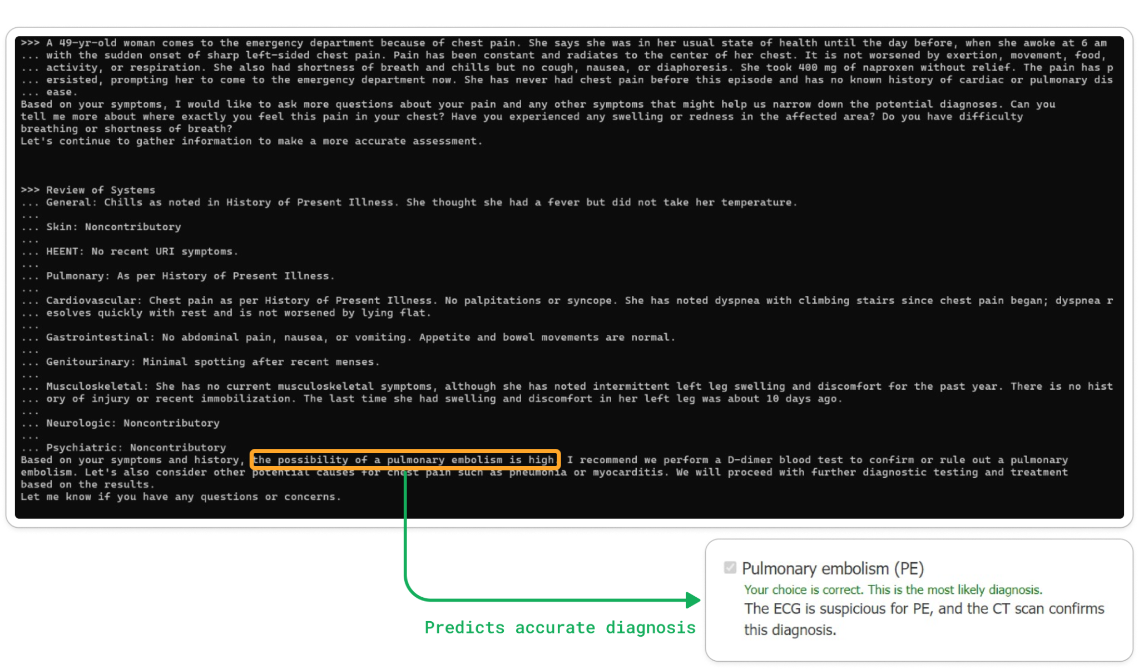

Slide 25
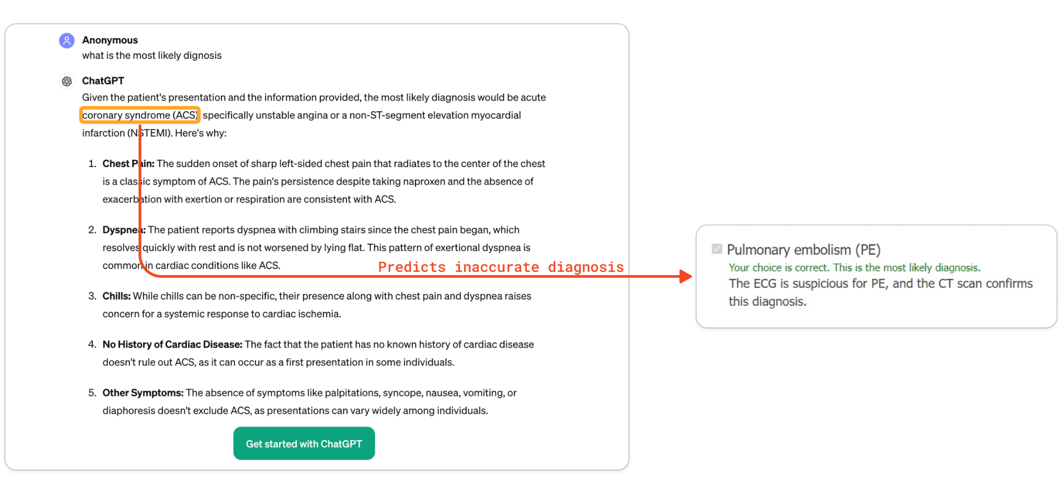

Slide 26

USER INTERFACE DEMO

Slide 27

Future Aspects
01
Improving Dataset
02
Aligning Fusion Layer in LLaVA Med
03
Better Retrieval Techniques

Slide 28
Thank You!

Slide 29
Image References

Slide 30
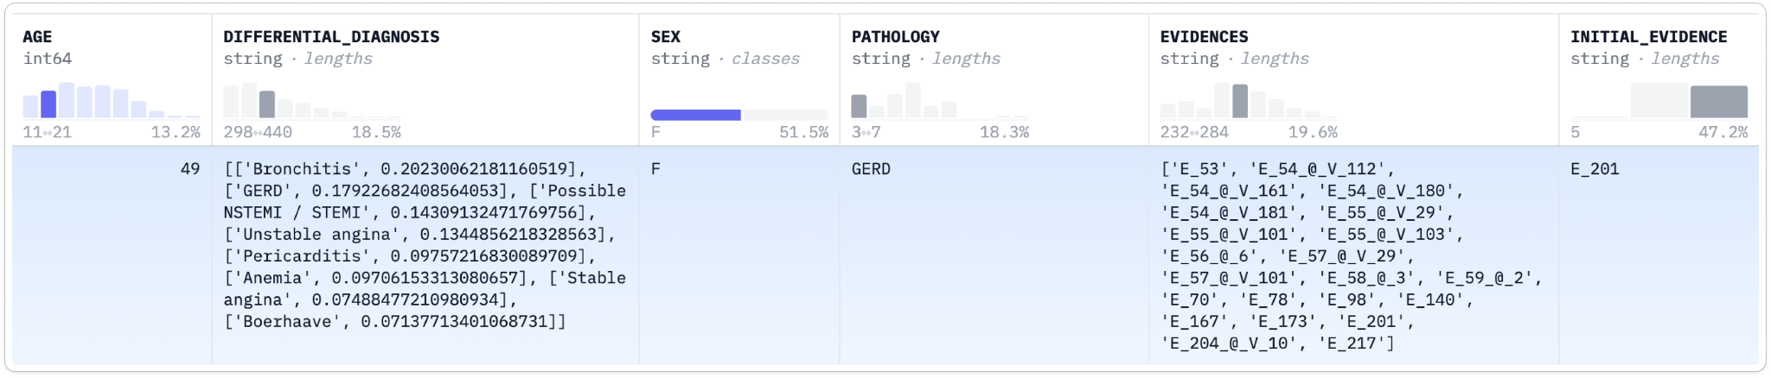

Slide 31
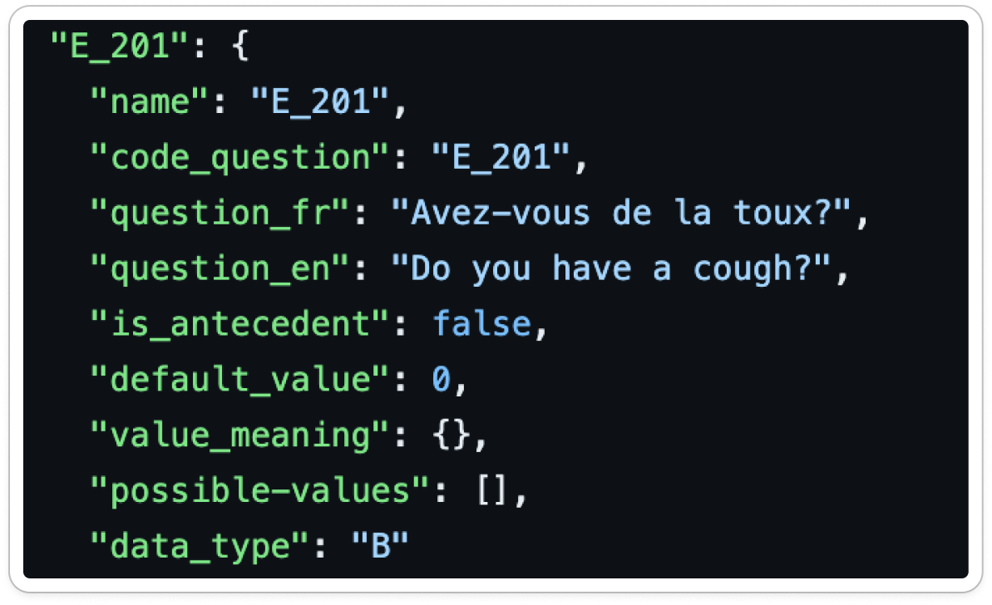

Slide 32
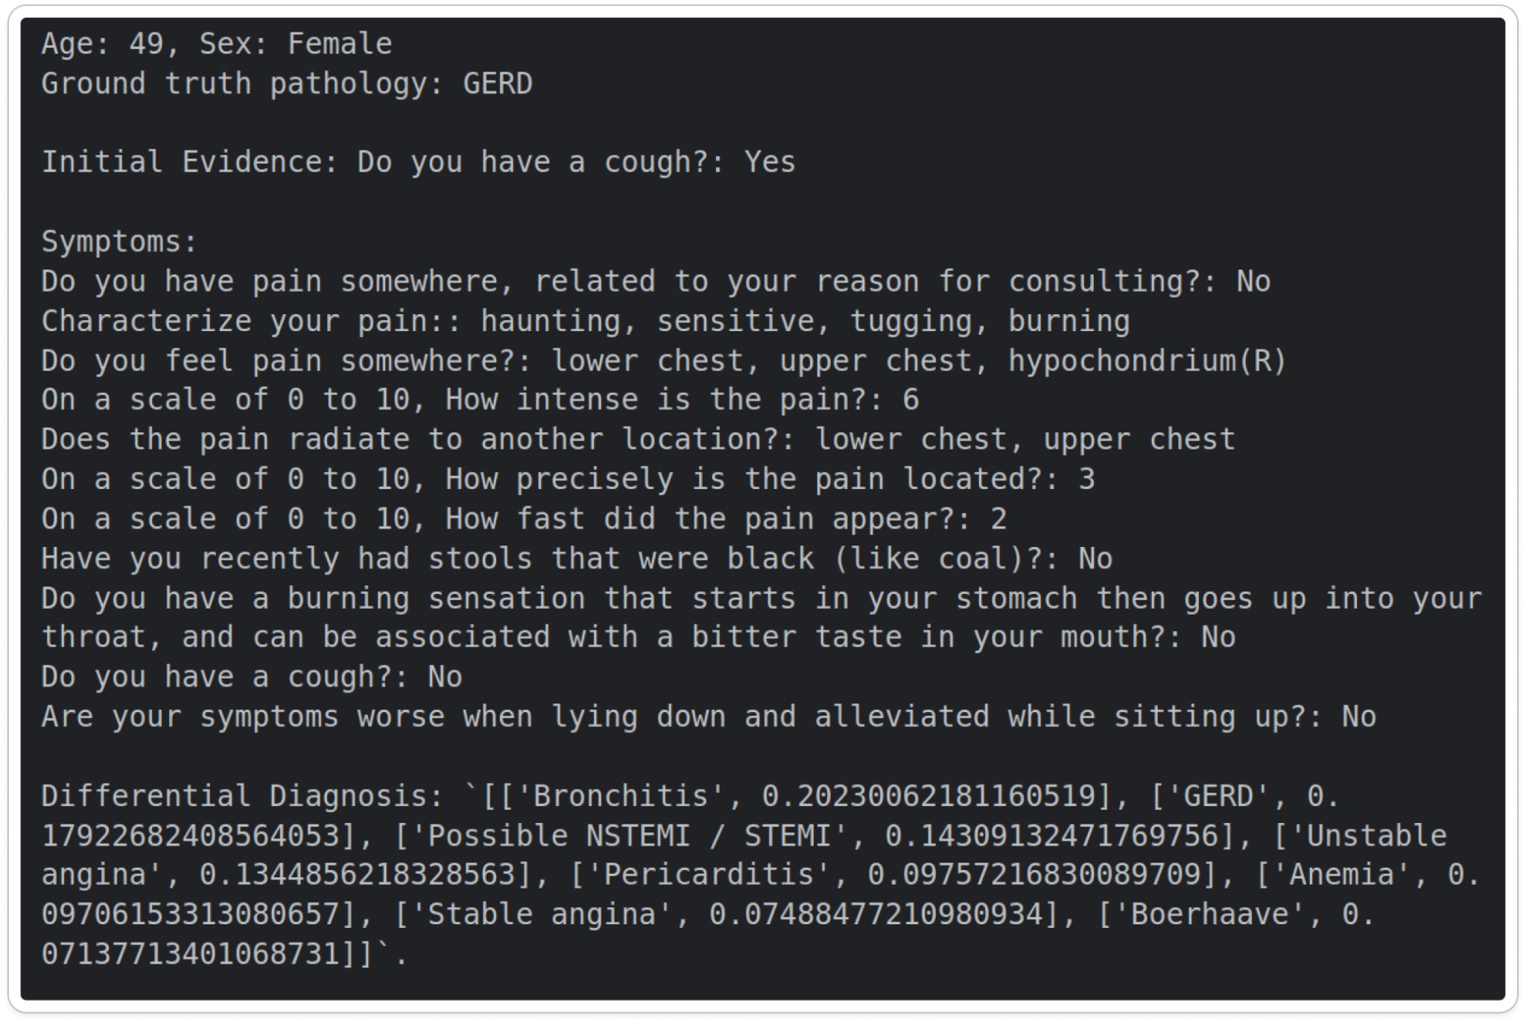

Slide 33
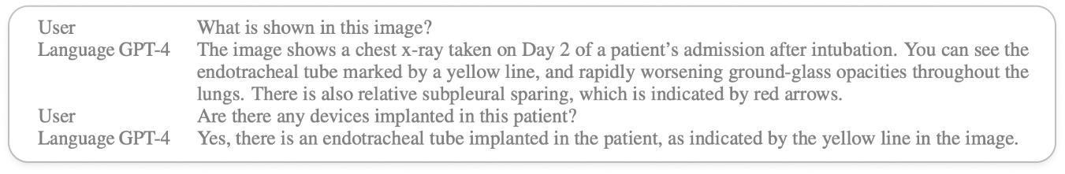

Slide 34
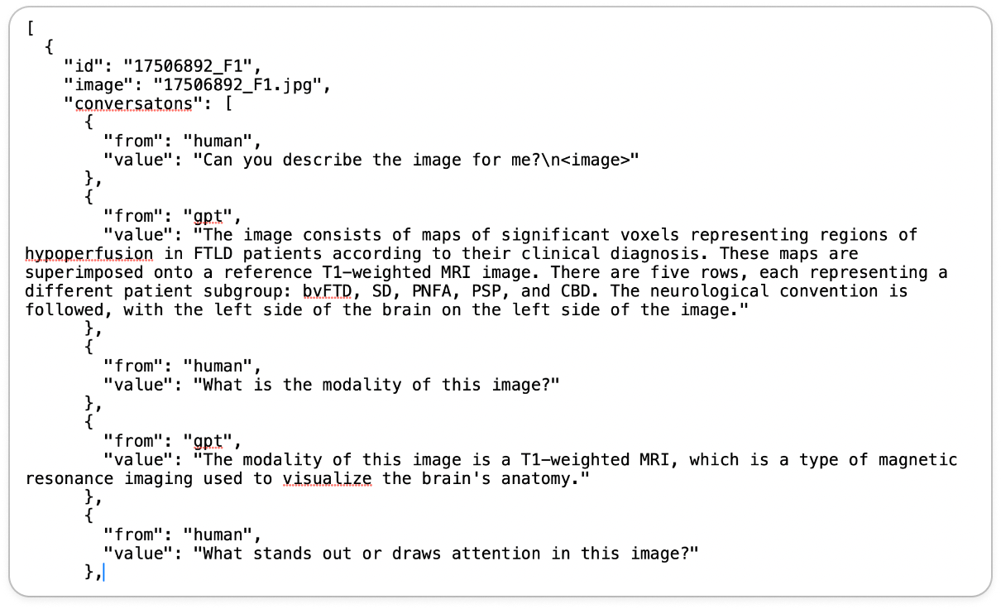

Slide 36
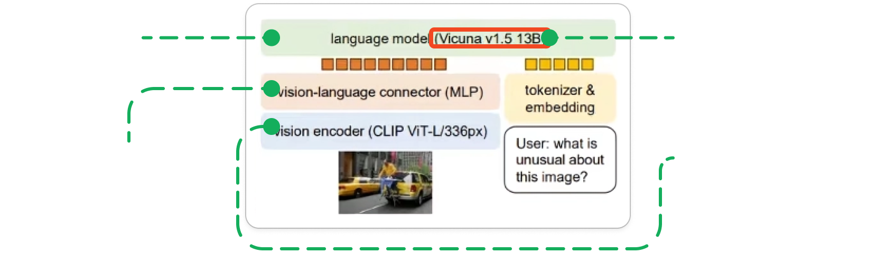
LLaVA Med’s Architecture

Slide 37
